Slide 1
Population
09
24
+14
Not The Meaning of Life=47

Slide 2
Warm Up
What are the problems of overpopulation?

Slide 3
world map

Slide 4
Cartogram?
car·to·gram
n.
A presentation of statistical data in geographical distribution on a map.

Slide 5
population map

Slide 6
gdp map (gross domestic product)
OR…
GDP = private consumption + gross investment + government spending + (exports − imports)
GDP is a measure of a country's overall economic output. It is the market value of all final goods and services made within the borders of a country in a year.

Slide 7
hiv/aids map

Slide 8
energy consumption

Slide 9
child mortality rate map

Slide 10
healthcare expense map

Slide 11
Think – Pair – Share
Turn to your neighbor and discuss each set of maps and what the largest regions/countries that are represented in the map.
Discuss why those regions/countries might be that way.

Slide 12
Population
09
25
+14
Bad at Math=48,251

Slide 13
Population Terms
Demography: the study of population
Arithmetic Density:
Physiological Density:
Agricultural Density:
CBR (Crude Birth Rate):
CDR (Crude Death Rate):
NIR or RNI (Natural Rate of Increase):

Slide 14
TFR: Total Fertility Rate
Which would have a higher TFR, developed countries like America or Israel or less developed countries like Angola or Saudi Arabia?
Average number of children a woman will have during childbearing years (ages 15-49)

Slide 15
World Total Fertility Rate
7-8 Children
6-7 Children
5-6 Children
4-5 Children
3-4 Children
2-3 Children
1-2 Children
0-1 Children

Slide 16
Population Geography
The Where and Why of Population
Density
Distribution
Demographics (Characteristics)
Dynamics

Slide 17
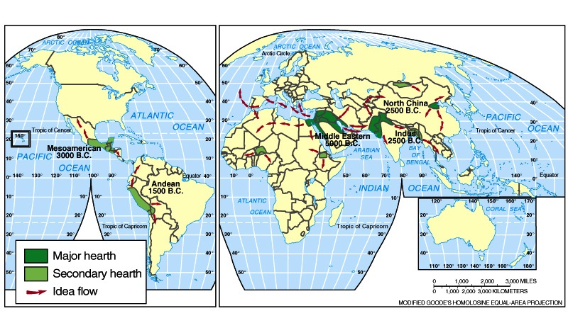
Cultural Hearths of Civilization

Slide 18
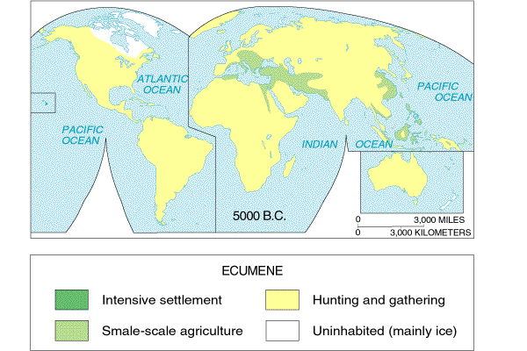
5000 BC

Slide 19
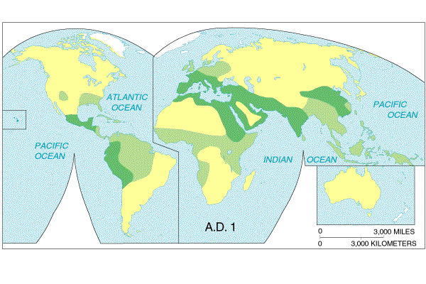
Year 1

Slide 20
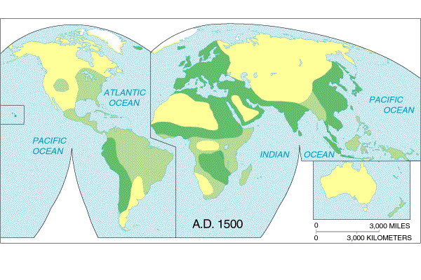
1500

Slide 21
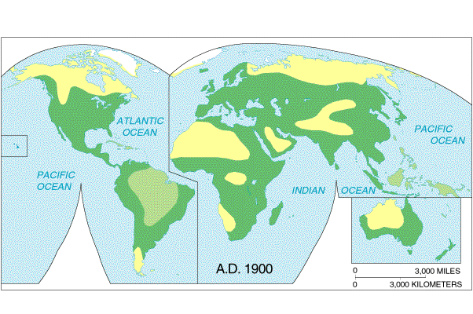
1900

Slide 22
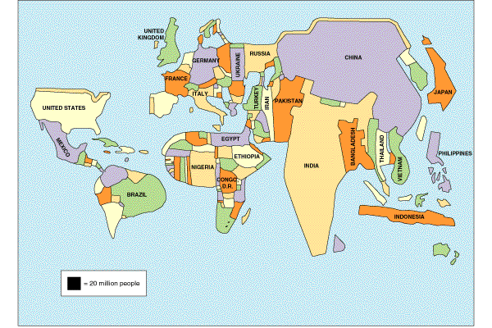
World Population Cartogram

Slide 23
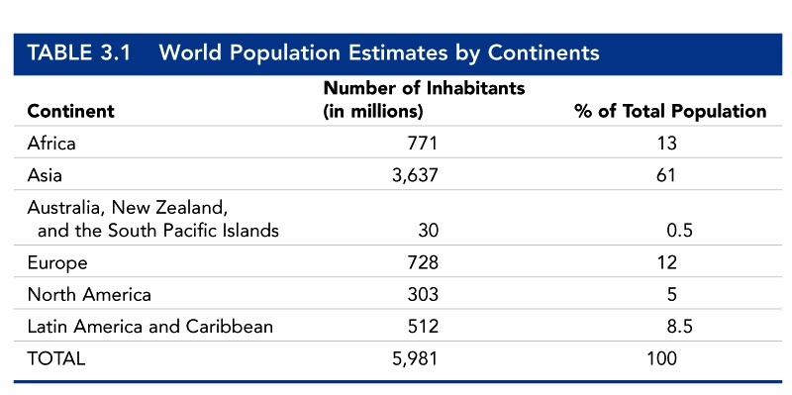
Population by continents
These numbers remind you of anything?
1072
15
4216
37
0.05
740
10.5
346
596
7007
2012 statistics

Slide 24
Density of World Population
Notes:
http://cc.owu.edu/~rdfusch/worldpopulationdensity.jpg
http://cc.owu.edu/~rdfusch/345maps2.htm

Slide 25
Let there be light
Notes:
http://antwrp.gsfc.nasa.gov/apod/image/0011/earthlights2_dmsp_big.jpg

Slide 26
Turn and Talk to Teammate
What are the differences or similarities between the Map of World Population and the World at Night photo?
What explains that difference?

Slide 27
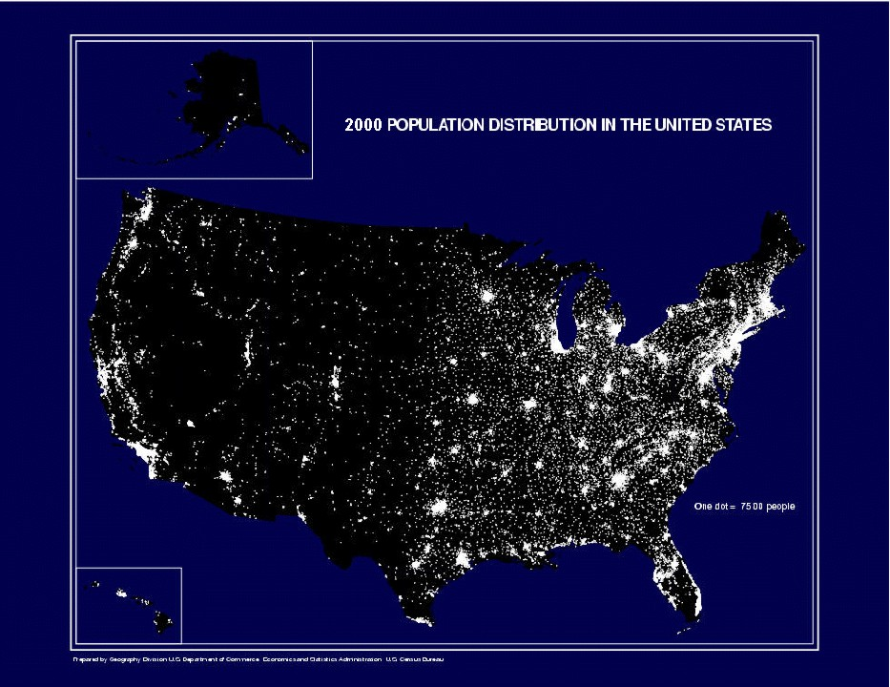

Slide 28
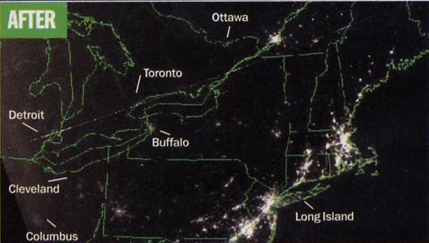
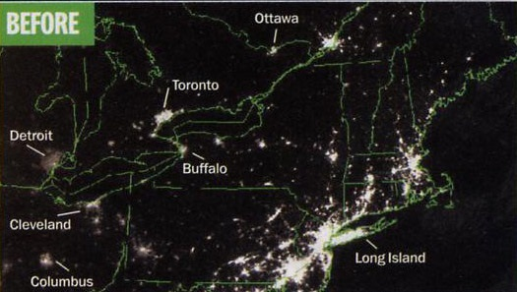
Blackout of 2003

Slide 29
Population
09
25
+15
Bad at Math=48,251

Slide 30
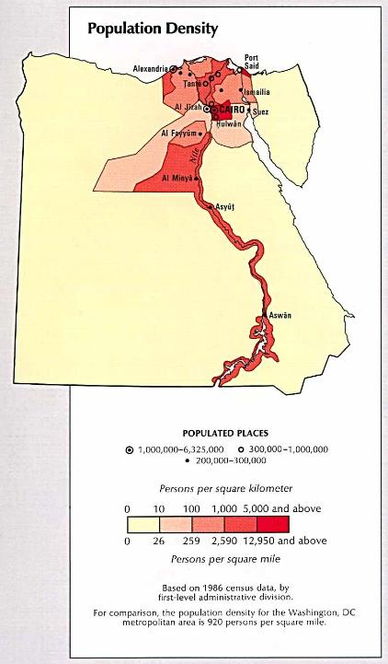
Population Densities (people/mi²)
Canada 8
Russia 22
United States 80
Holland 1002
Bangladesh 2261
Egypt
173 people/mi²
3% of area inhabited
Nile River
6000 people/mi²
Notes:
http://www.al-bab.com/arab/econ/economy.htm

Slide 31
High density in Bangladesh
Notes:
http://www.bangladeshgov.org/bdmaps/
www.internations.net/jp/ mushfiqul/flood1.jpg
http://home.earthlink.net/~shubhrasudha/bdesh15.jpg

Slide 32
Census: Count of population and its characteristics

Slide 33
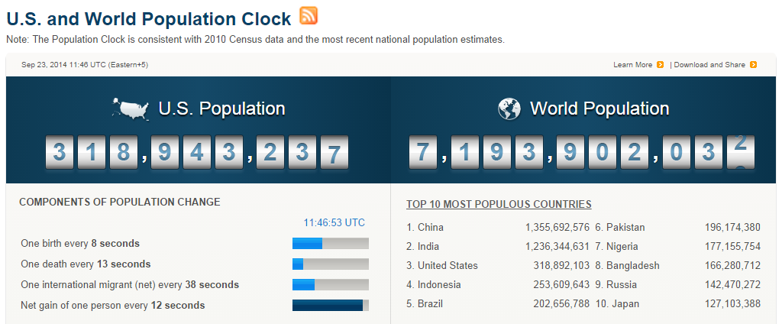
Census: Count of population and its characteristics

Slide 34
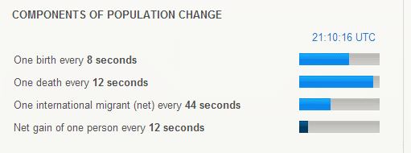
Census: Count of population and its characteristics
Notes:
http://www.census.gov/cgi-bin/popclock

Slide 35
Census: Count of population and its characteristics
Notes:
http://www.census.gov/cgi-bin/popclock

Slide 36
Census: Count of population and its characteristics
Notes:
http://www.census.gov/cgi-bin/popclock

Slide 37
Census: Count of population and its characteristics
Notes:
http://www.census.gov/cgi-bin/popclock

Slide 38
Rate of Natural Increase (RNI)
Births
- Deaths
=
RNI

Slide 39
National population growth
Births
- Deaths
+ Immigration (in)
Emigration (out)
=
Population growth

Slide 40
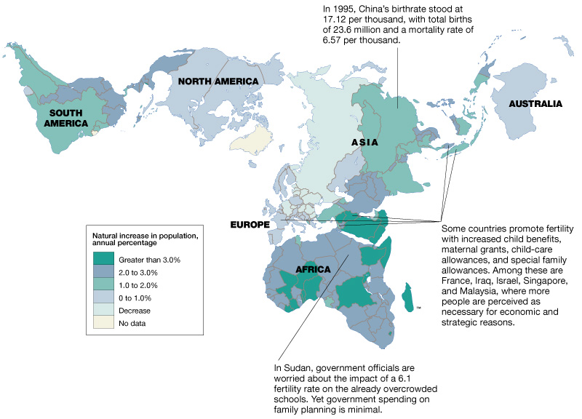
Population increase and decrease

Slide 41
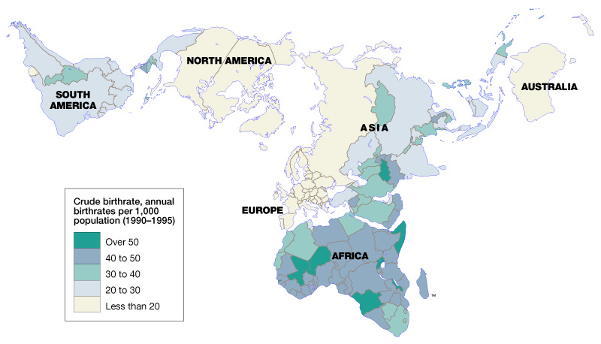
World Birth Rate (births per 1,000 population)

Slide 42
Doubling Time
Number of years
it will take for population to double, at current rate
United States: 117 years
Nicaragua: 21 years
Notes:
http://www.worldpop.org/datafinder.htm

Slide 43
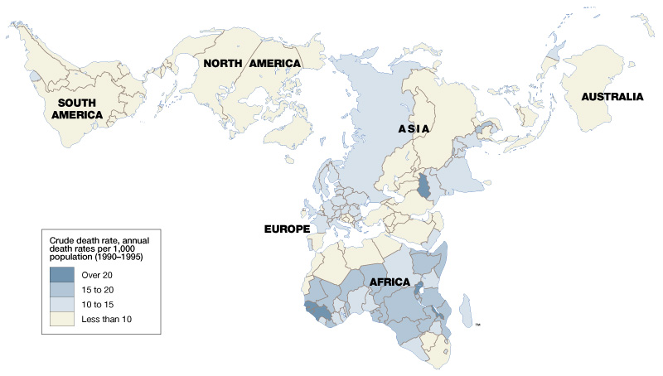
World Death Rate (deaths per 1,000 population)

Slide 44
What other factors greatly affect population growth or decrease?

Slide 45
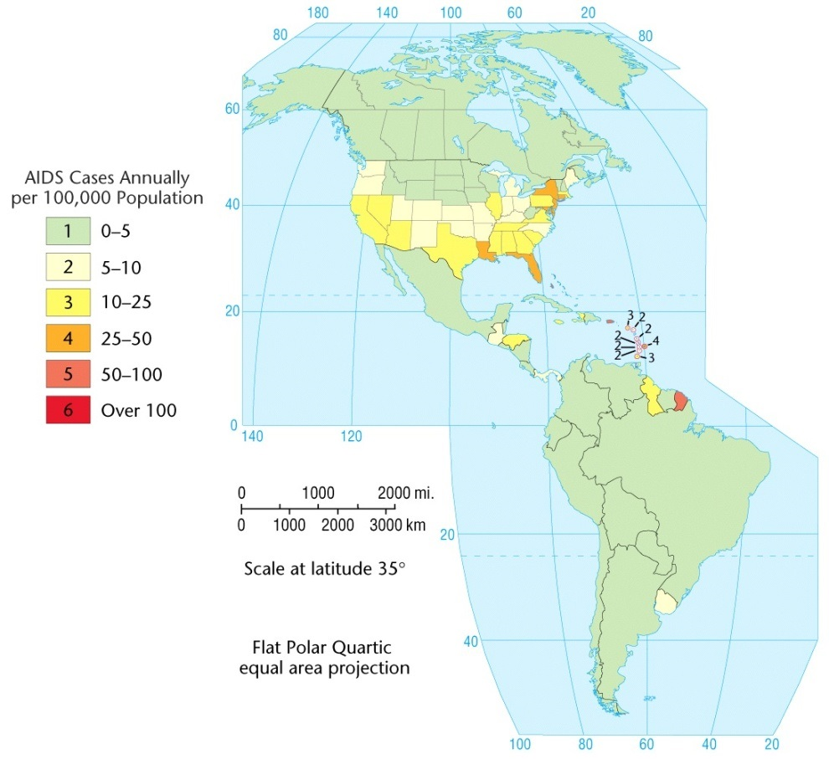
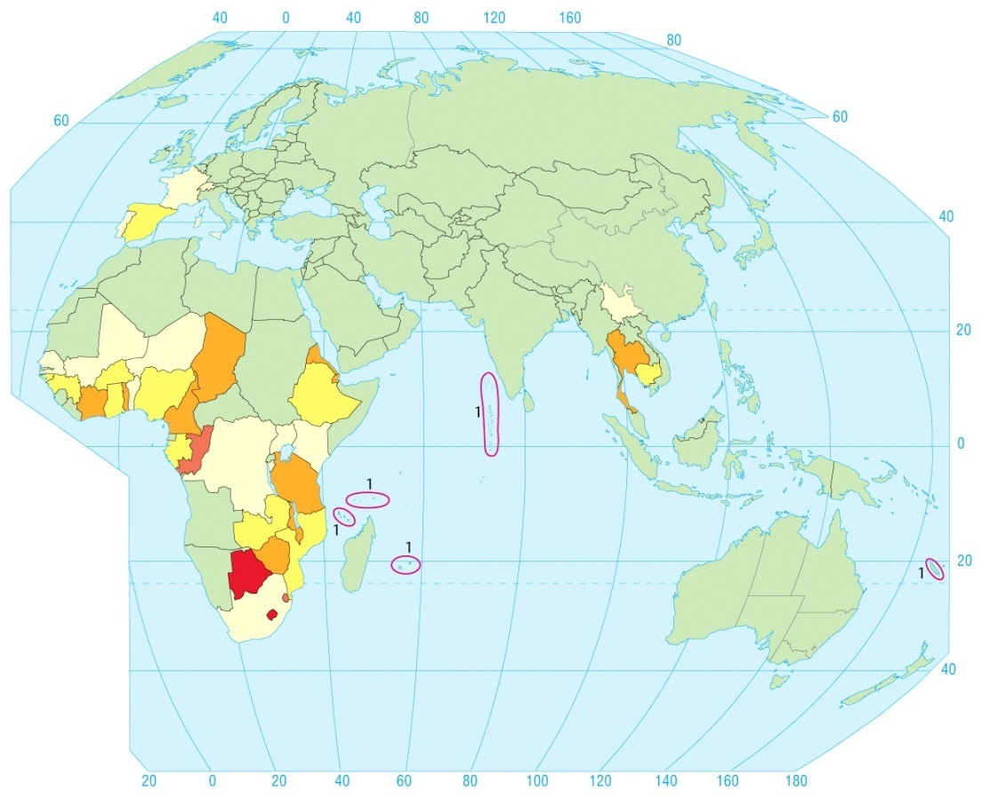
Epidemics (AIDS)

Slide 46
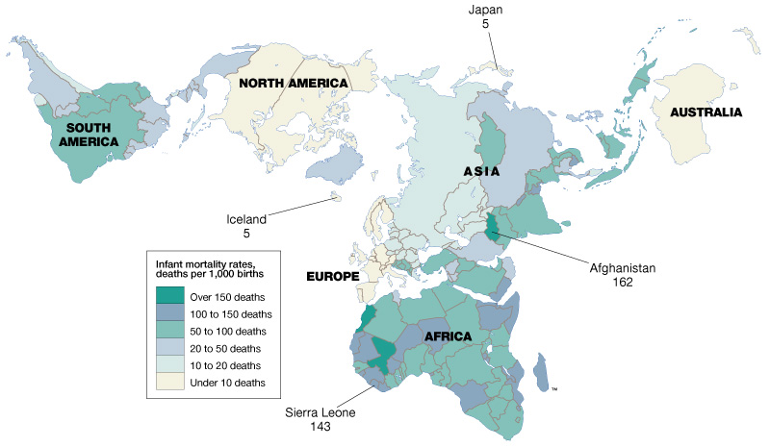
Infant mortality rate (deaths of infants <1 year old)
Lack of maternal health care or child nutrition

Slide 47
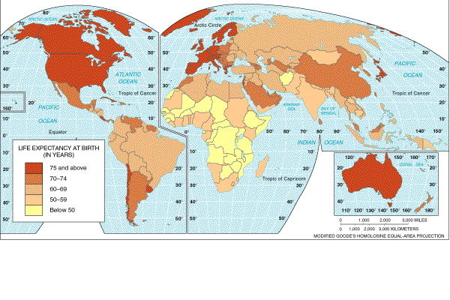
Life Expectancy at Birth

Slide 48
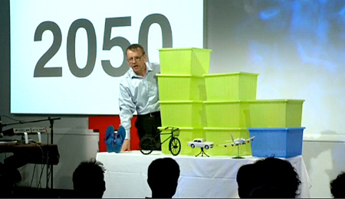
Hans Rosling: Global population growth, box by box
https://youtu.be/fTznEIZRkLg
Uncle Hans Rosling: (born 27 July 1948) is a Swedish medical doctor, academic, statistician and public speaker. He is Professor of International Health at Karolinska Institute and co-founder and chairman of the Gapminder Foundation, which developed the Trendalyzer software system to make statistics fun and accessible.

Slide 49
A moment to process…
Take a moment to write down in your notebook the THREE most powerful new or adjusted understandings that you have after listening to Uncle Hans discuss global demographics.

Slide 50
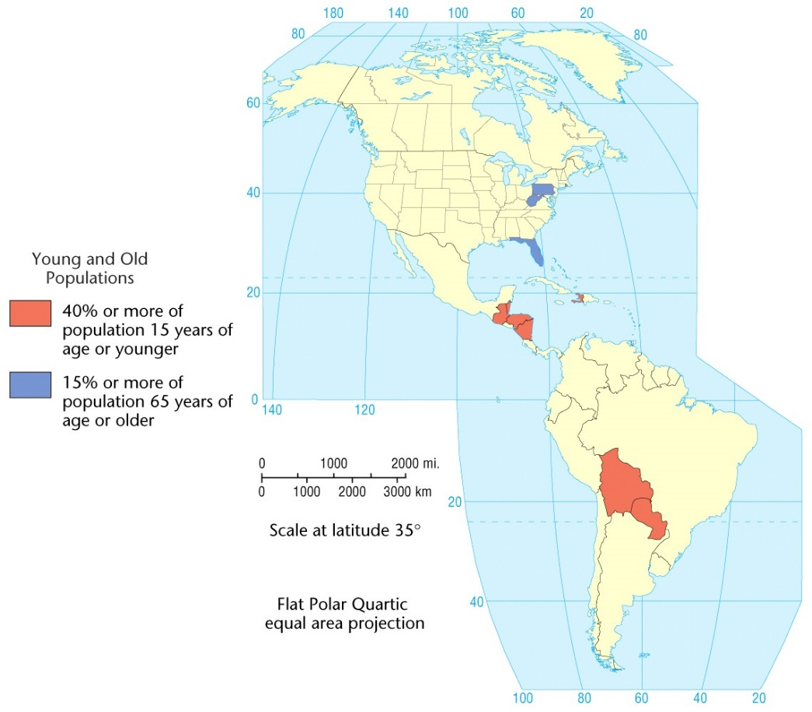
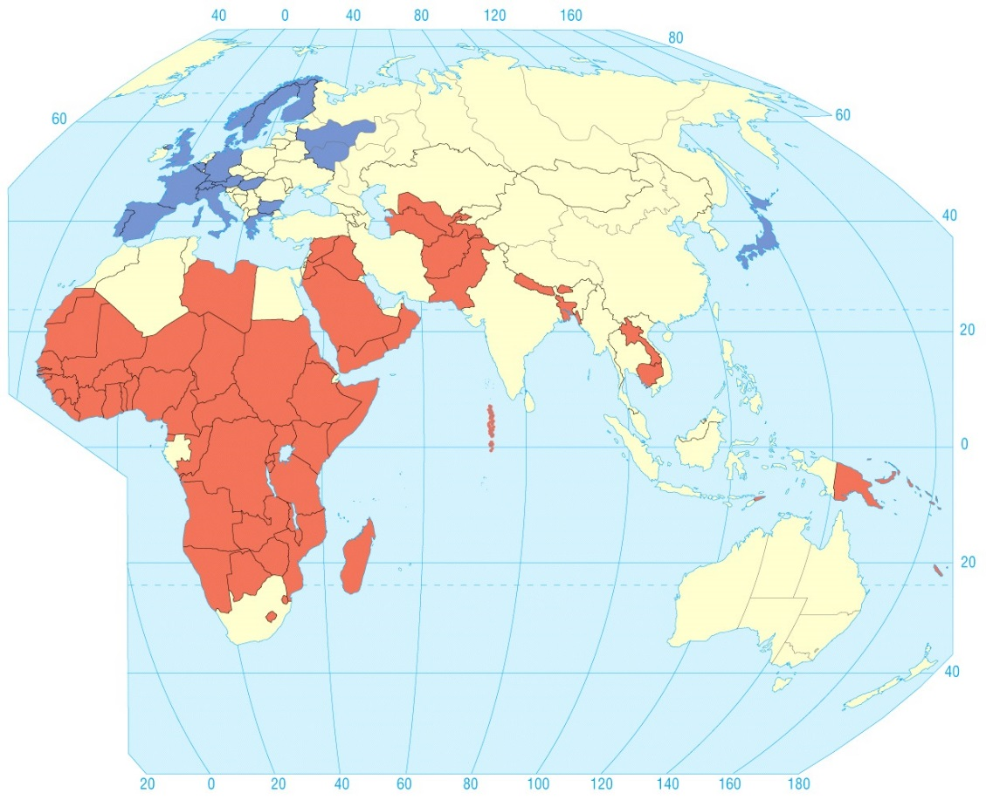
AGE DYNAMICS

Slide 51
Dependency Ratio
Dependents are under 15 & over 65
How many are supported by 15-65 group
Problems?

Slide 52
“The Core”
Europe
North America
Australia
Japan

Slide 53
“Graying of the Core”
Low birth and death rates in Core
Low population growth
(except immigration)
Steadily older population

Slide 54
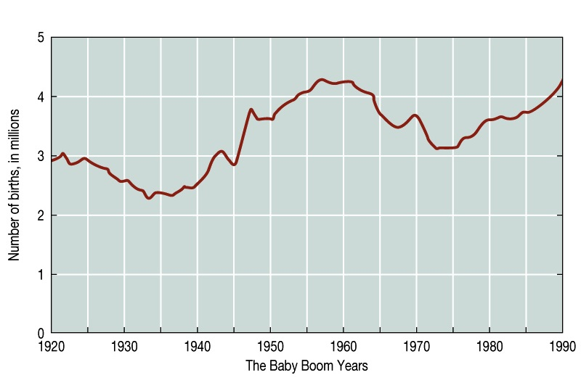
Baby Bust (1965-1980)
Baby Boom (1946-1964)

Slide 55
Baby Boom impacts yet to come
More people retiring over the next few years, than ever before…

Slide 56
Turn and Talk to Teammate
What is a problem of more people in the “dependency age group” and less in the working class?

Slide 57
Population Pyramids

Slide 58
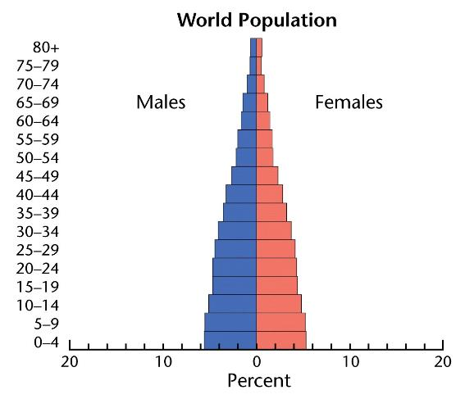
Population Pyramid tracks age-sex groups (cohorts)

Slide 59
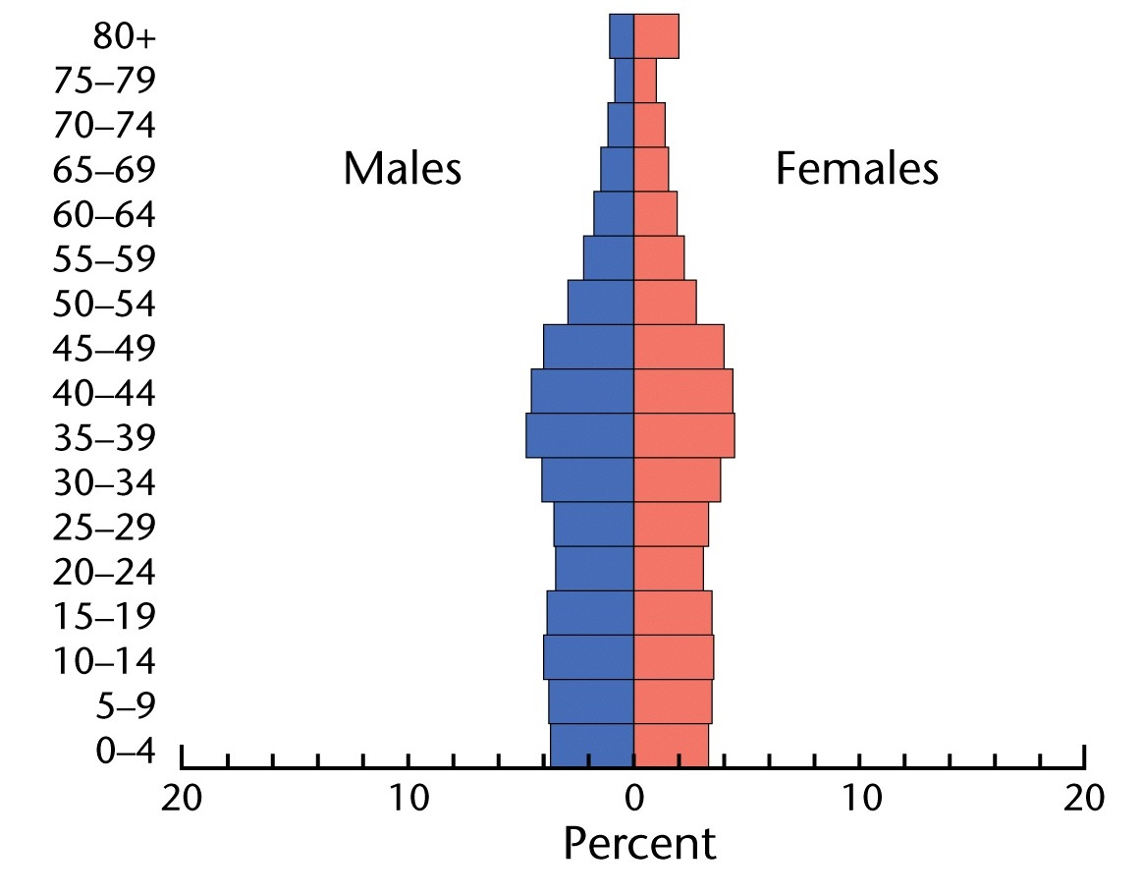
U.S. (slow growth)

Slide 60
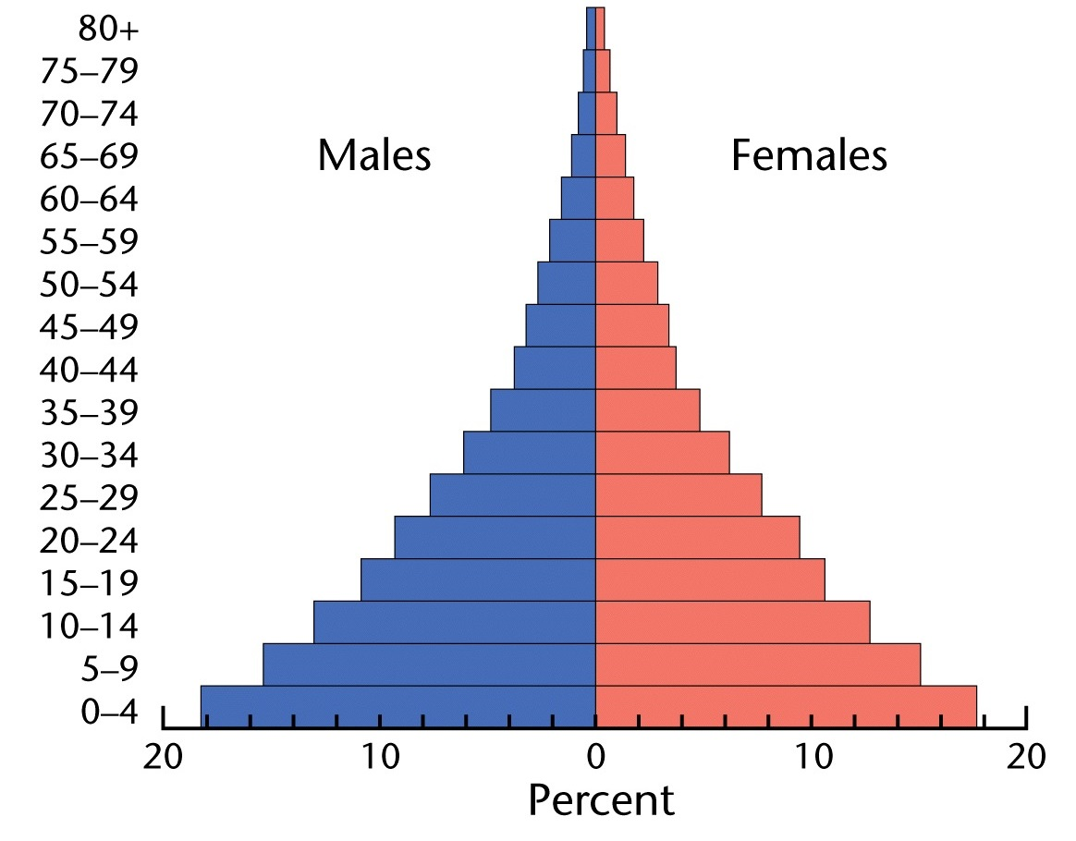
Tanzania, Africa (rapid growth)

Slide 61
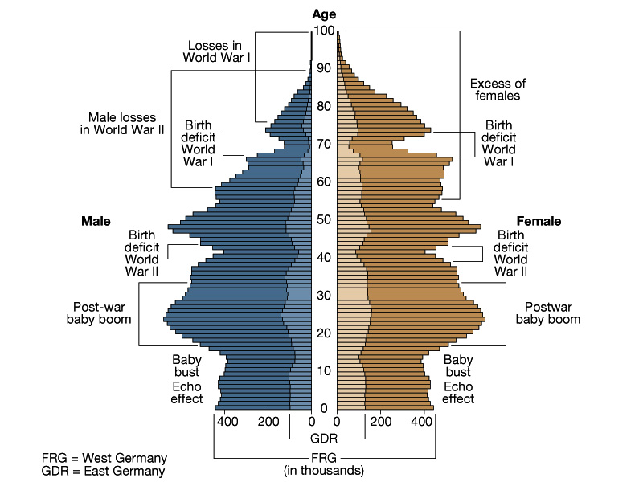
Germany (effect of wars)

Slide 62
Japan (effect of war)
Notes:
http://www.stat.go.jp/english/data/kokusei/2000/kihon1/00/00.htm

Slide 63
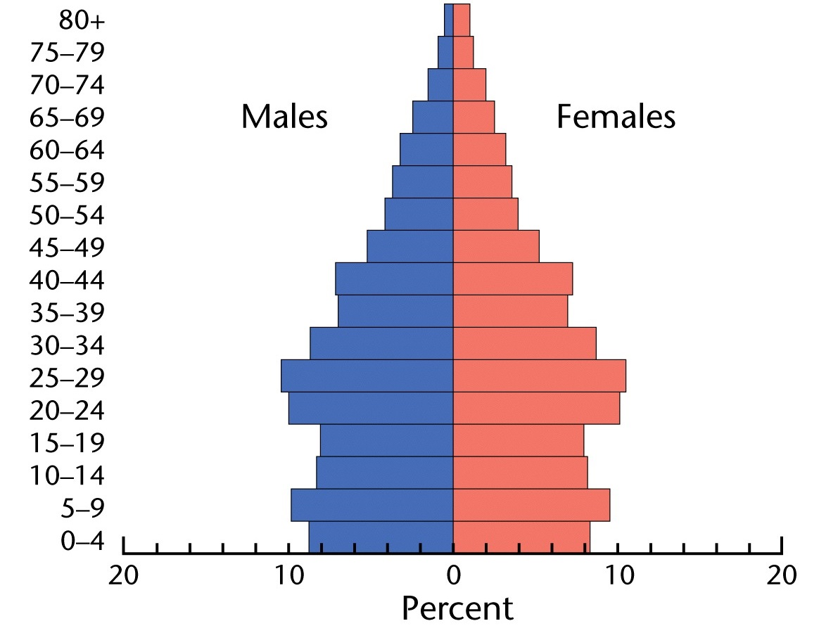
China (One-child policy)

Slide 64
Arabian Peninsula, 1980s Labor sending : Labor receiving

Slide 65
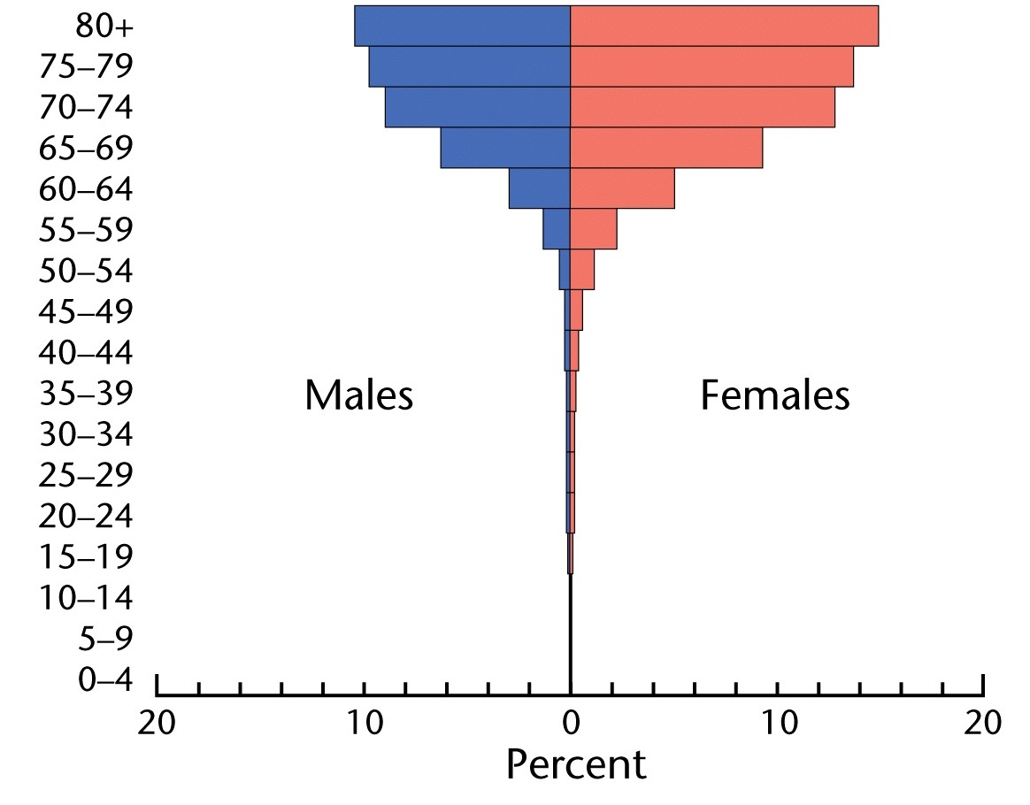
Sun City (Arizona)
retirement community

Slide 66
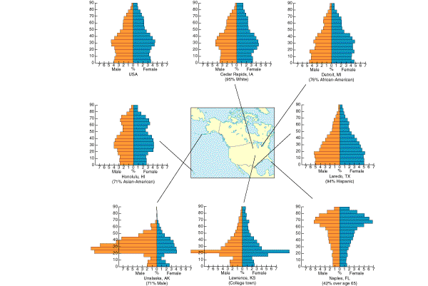

Slide 67
Population Pyramid Activity
Use the handout to work in your duos/trios to create the population pyramids
Canada and Bolivia

Slide 68
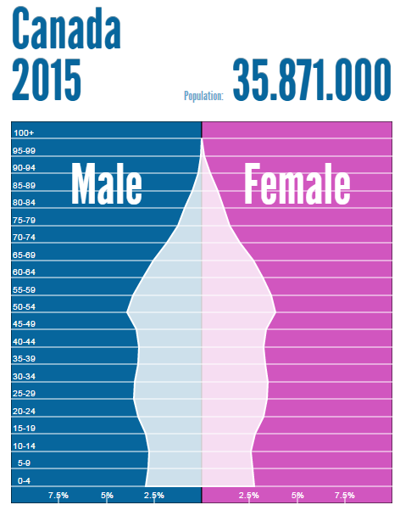
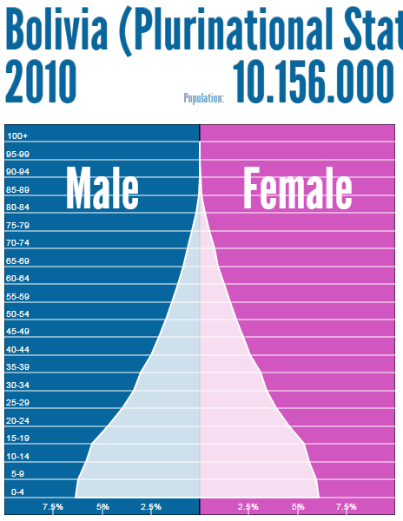

Slide 69
Demographic Transition
Move from high birth and death rates
to low birth and death rates
Took centuries of development
for Core to make transition
More difficult for Periphery
to make transition without its
own capital, skills, education

Slide 70
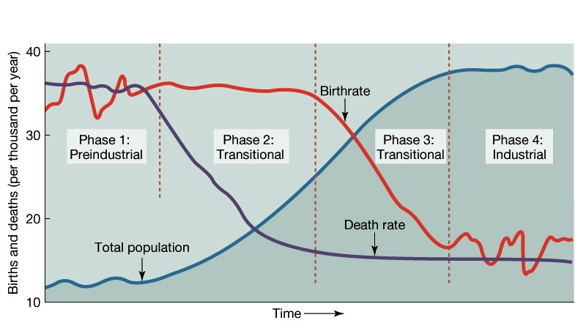
Demographic Transition
Stage 1 Stage 2 Stage 3 Stage 4
Agricultural-Industrial
Hunter-Gather Societies
Early Agriculture
Industrial
Modern Industrial - Services

Slide 71
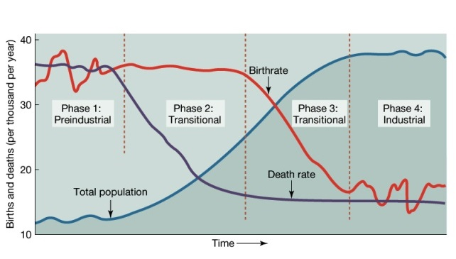
Stages of Demographic Transition
1. Pre-Agricultural/early Agriculture
(high birth/death rates)
2. Agricultural & early Industrialization
(better sanitation)
1
2
3
4
3. Developed industrialization
(better health care)
4. Post-Industrial Equilibrium
(low birth/death rates)

Slide 72
Stage 5?
Stage five has been added by some demographers to illustrate changes in population seen in MDCs which have below replacement level fertility rates (<2.1).
Most European countries have death rates which are above birth rates and are considered to be in stage five.

Slide 73
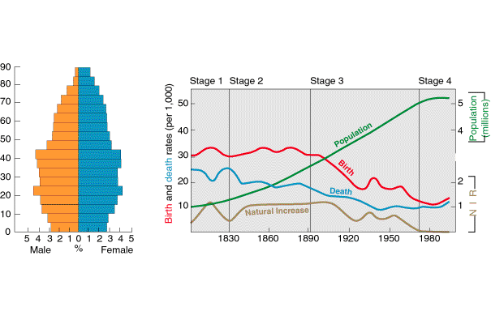
Demographic Transition in Denmark
MDC (More Developed Country) CORE (low birth/death rates)

Slide 74
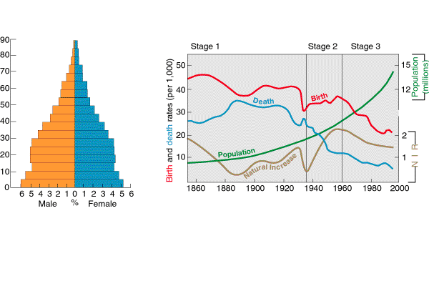
Demographic Transition in Chile
NIC (Newly Industrialized Country) SEMI-PERIPHERY

Slide 75
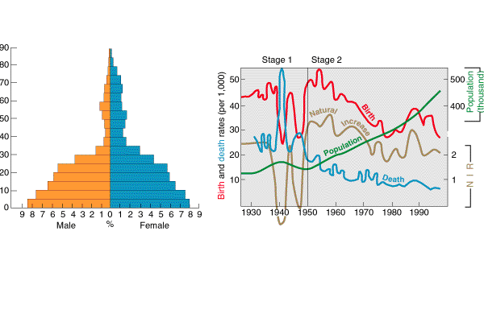
Demographic Transition in Cape Verde, Africa
LDC (Less Developed Country) PERIPHERY (high birth/death rates)

Slide 76
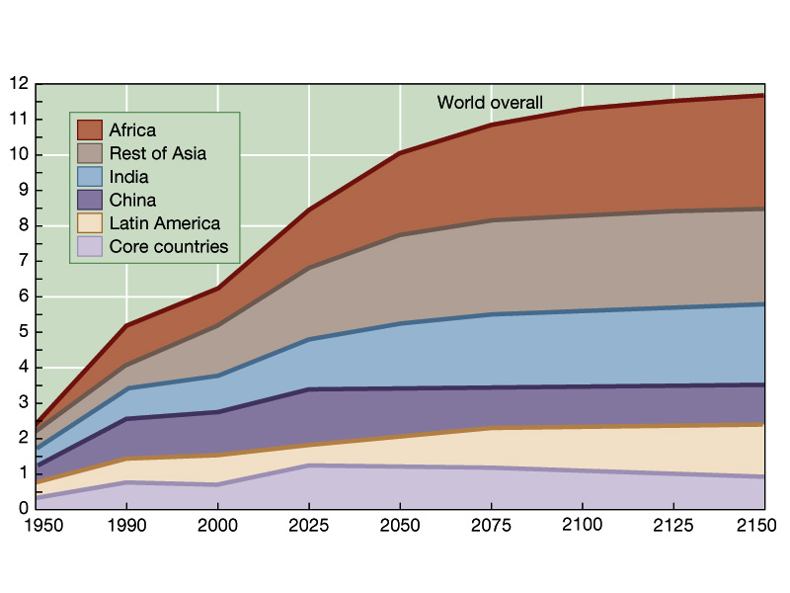
POPULATION GROWTH

Slide 77
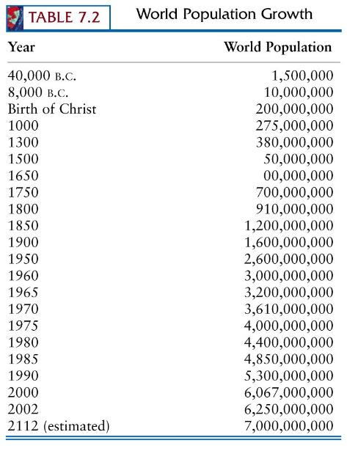
Population growth
in Periphery:
Cause or symptom
of poverty and environmental degradation?
4
5
2012

Slide 78
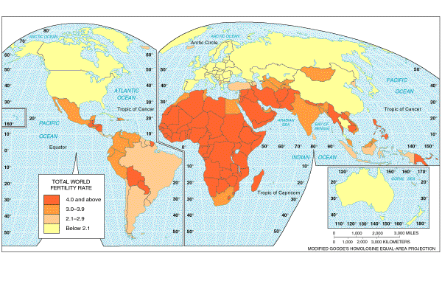
Total Fertility Rate (TFR) (# children per woman of childbearing age)

Slide 79
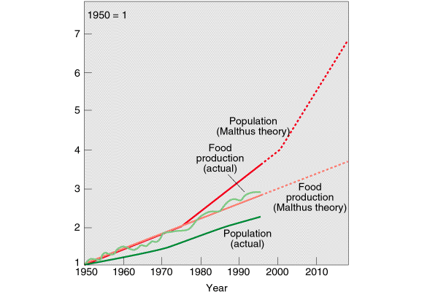
Thomas Malthus’ Theory of “Overpopulation”
Not confirmed in reality

Slide 80
Reading Due Thursday
Thomas Malthus
After reading the article, “An Essay on the Principle of Population” respond to the following questions in a typed, double-spaced, 2-3 page response.
Nicholas Eberstadt
After reading the article, “Population Implosion” respond to the following questions in a typed, double-spaced, 2-3 page response.

Slide 81
Density of World Population
Create your own Population Density Map. Use any colors you want just put them in the key to represent density.
You will be graded on accuracy and neatness.
Notes:
http://cc.owu.edu/~rdfusch/worldpopulationdensity.jpg
http://cc.owu.edu/~rdfusch/345maps2.htm

Slide 82
Warm Up
Read de Blij article on Overpopulation and answer questions on the back.

Slide 83
Overpopulation Monday
10.01.12

