Slide 1
British Isles & Paris – Spring Break 2014

Slide 5
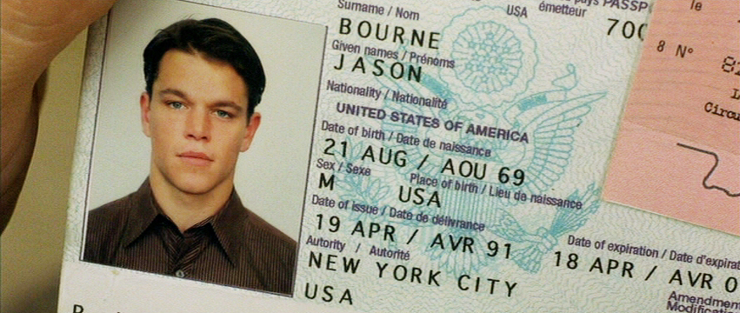
Passports?
Get at least 6 weeks before (Nov-Jan)
Smile

Slide 6
What to Pack?
TRAVEL LIGHT!
EF Tours list and Bob’s list
Carry-on VS. Check-in
Prescriptions

Slide 7
What to Buy?
Electrical converters, cell phone plans, Viber/Skype, travel sized items, rainy clothing, contacts, journal
flashlight?
alarm clock?
light rain jacket?
small/light umbrella?
FLEEEEEEEEEEEEEEEEEEEEEEEEEEEEEEEEEECE

Slide 9
Future Meetings
January Meeting (1/13-17)
Practice for the trip
Order money from banks (Euros, Pounds)
Packing List
Meals
February Meeting (2/3-7)
Practice for the trip
Procedures (passport control, baggage customs, hotels, travelling, bus, etc.)

Slide 11
Rooming Arrangements

Slide 12
Fundraisers?

